Slide 1
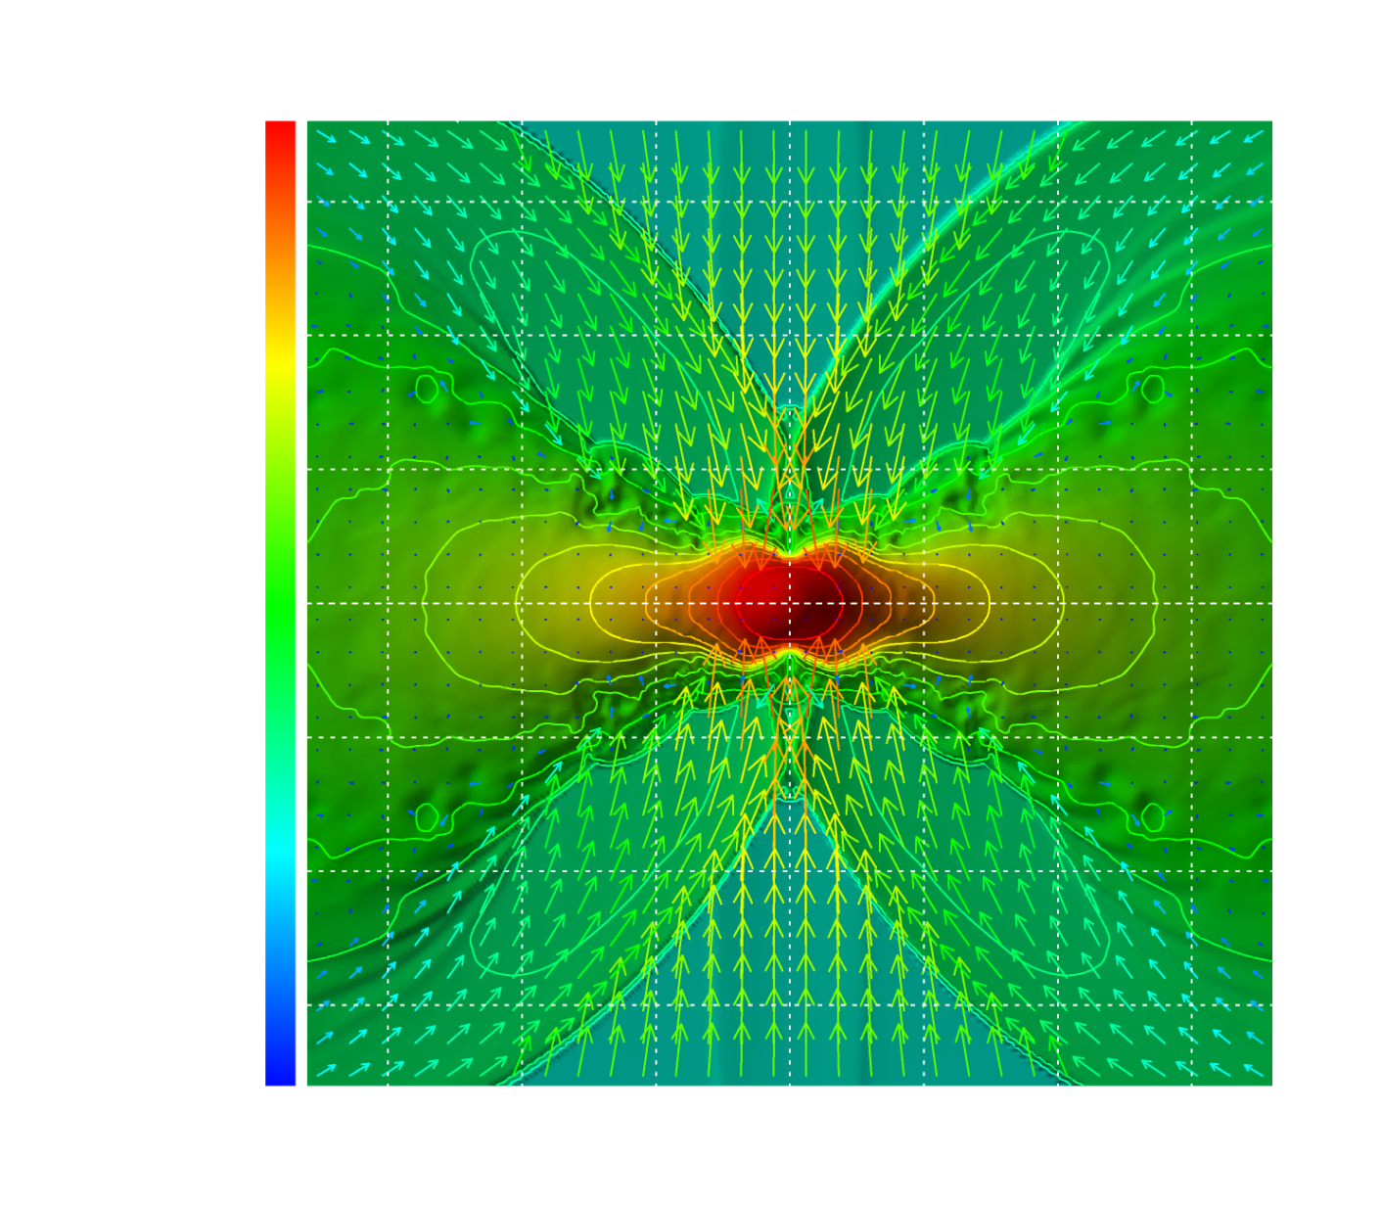
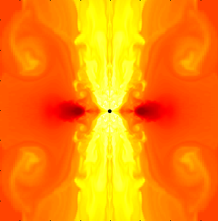
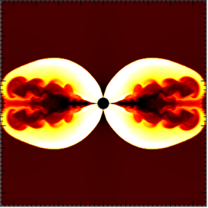
Formation and Evolution of BH+Disk in Stellar Core Collapse
Yuichiro Sekiguchi (YITP)
Notes:
My name is Yuichiro Sekiguchi. I would like to thank to organizers for giving me this nice chance to talk about our recent studies. The topics I will present you now will be rather different from those of previous speakers : I will talk about an “Astrophysical aspect” of black holes.

Slide 2
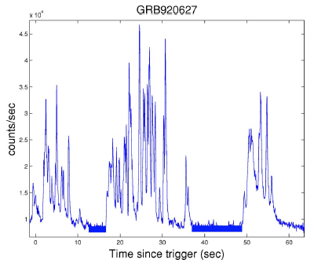
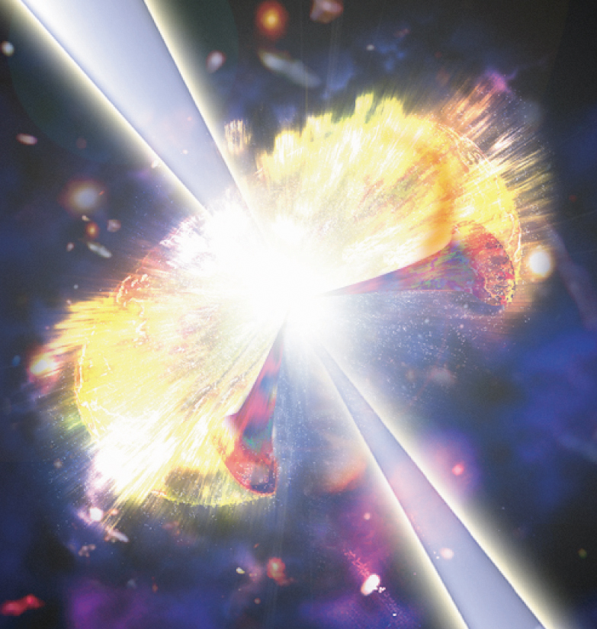
Motivation: BH formation and LGRBs
Collapse of massive stellar core to BH + Disk
One of Promising theoretical candidates of central engine of Long Gamma-ray Bursts (LGRBs)
Time Profile
Highly Time-variable
Disk
BH
0 10 20 30 40 50 [s]
10⁵⁰erg/s < L_{γ} < 10⁵²erg/s
Most violent explosion in the universe
Notes:
The main motivation to study the collapse of massive stellar core to BH and Disk is that, such system is the most promising theoretical candidates of central engine of Long Gamma-ray Bursts. Long gamma-ray burst is the most violent explosion in the universe which emits huge amount of energy in a short time. There is a black hole and disk, and by some mechanism which is not fully understood, ultra-relativistic outflow (Jet) is generated, interactions inside the jet produce gamma-rays observed as this light curve. One of the possible mechanism to drive this jet is production of electron-positron pair hot plasma by pair annihilation of neutrinos.

Slide 3
To produce LGRB
If the LGRB jet is produced by neutrino pair annihilation
Huge amount of neutrinos should be emitted
in a highly time-variable manner
Notes:
So, If the LGRB jet is produced by neutrino pair annihilation, huge amount of neutrinos and anti-neutrinos should be emitted in a highly time-variable manner. We want to study whether or not this requirement is satisfied in the stellar core collapse to black hole and disk.

Slide 4
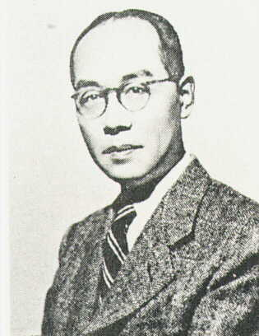
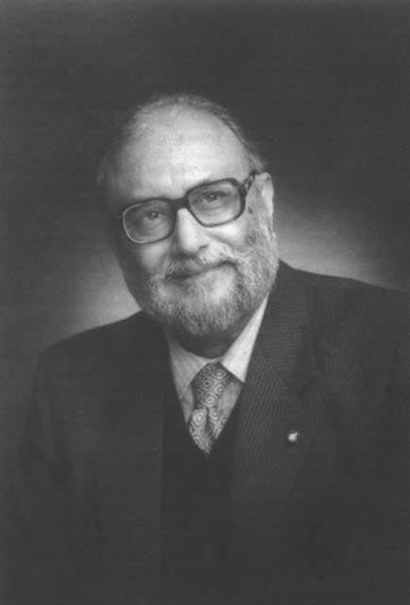
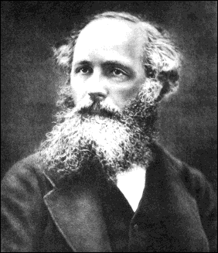
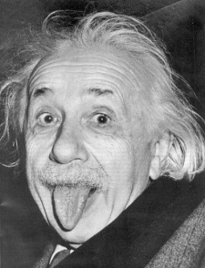
Basic Equations and Physics
Solve Einstein’s equation with eqs. for source fields
All four known interactions play important roles
Gravity : GR, BH formation, ISCO, etc
Strong : EOS (equation of state ) of dense nuclear/hadronic matter
EM : MHD phenomena, EOS of dense matter
Weak : Electron capture, Neutrino production
99% gravitational binding energy released is carried away by neutrinos in SNe
Numerical Relativity
Notes:
To do so, we must solve Einstein’s equation together with the equations for source fields. Namely, the local conservation equation of energy momentum and continuity equation for baryons and leptons. The energy momentum tensor will be composed of ideal fluid, electromagnetic field, neutrinos and so on.
All four known interactions play important roles: Of course Gravity is important, Strong interactions is essential in describing EOS of dense nuclear matter.
EM is also important for EOS, and if there are strong magnetic fields, MHD phenomena become important. Weak interaction is very important in driving thermal and chemical evolution of the system. Note that because of high density, electrons and photons are trapped in the fluid and only neutrinos can carry energy and lepton number. Eventually, 99% of gravitational binding energy is carried away by neutrinos.

Slide 5
BH formation 2005
Initial condition : rotating polytrope
Microphysics was not included
The simulation was terminated shortly after the BH formation
Notes:
Before moving on the latest results, let me show you the results in 2005. At that time, we adopt a very approximate setting : Initial condition is rotating polytrope, and Microphysics such as detailed EOS and weak interaction is not included. Moreover, the simulations were terminated shortly after the BH formation because at that time, we did not know how to treat the BH singularity.

Slide 6
BH formation 2005
Disk
BH

Slide 7
BH formation 2010-2011: Setting
(Very) Brief summary of simulation code
Initial conditions
Notes:
OK, now let me show you our latest results.

Slide 8
Summary of Code
Sekiguchi (2010) Progress of Theoretical Physics 124, 331
Einstein’s equations: Puncture-BSSN formalism
4th order finite difference in space, 4th order Runge-Kutta time evolution
Gauge conditions : 1+log slicing, dynamical shift
GR Hydrodynamics with GR Leakage Scheme (Sekiguchi 2010)
EOM of Neutrinos and Lepton Conservations
Nuclear-theory-based EOS (Shen et al. 1998)
Weak Interactions
e± captures (Fuller et al 1985),
e± pair annihilation (Cooperstein et al. 1986)
plasmon decay (Ruffert et al. 1996)
Bremsstrahlung (Burrows et al. 2006)
Neutrino opacities (Burrows et al. 2006)
(n,p,A)-scattering and absorption
Recoil corrections (Horowitz 2001)
High-resolution-shock-capturing scheme
BH excision technique
Notes:
This slide briefly summarize the setting of the simulations. I do not explain much about details. Important sophistications are that the equation of motion for neutrinos and lepton conservation equations are solved, taking account of detailed microphysics: nuclear-theory-based EOS, and detailed weak processes.

Slide 9
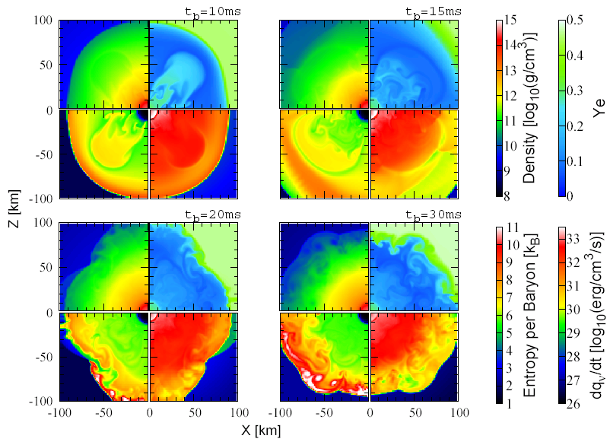
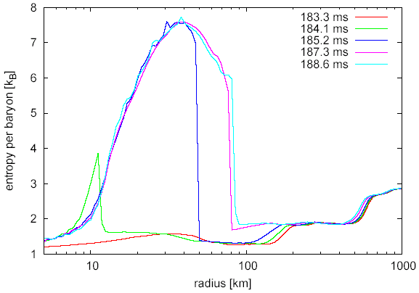
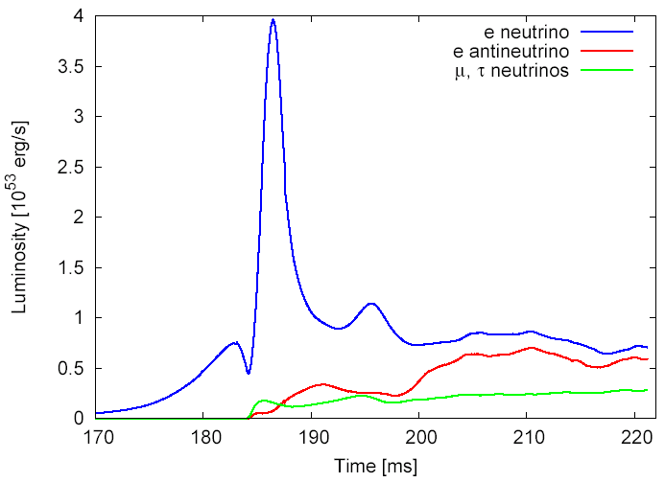
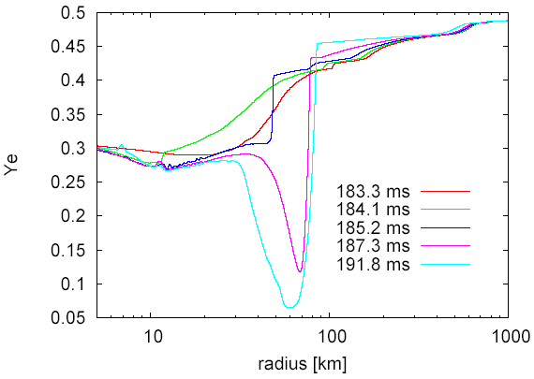
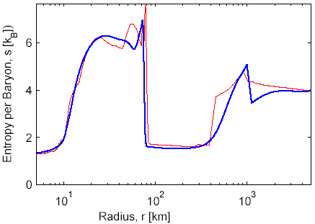
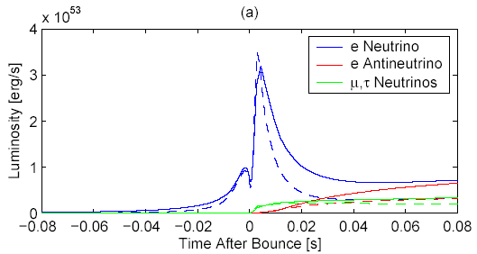
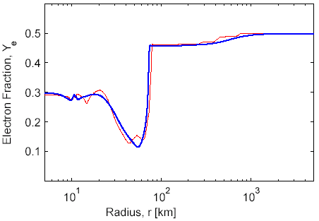
Code Validity (Spherical collapse)
Comparison with 1D GR Boltzmann (Liebendorfer et al. 2004)
Approximate agreements in Ye, entropy, and luminosities

Slide 10
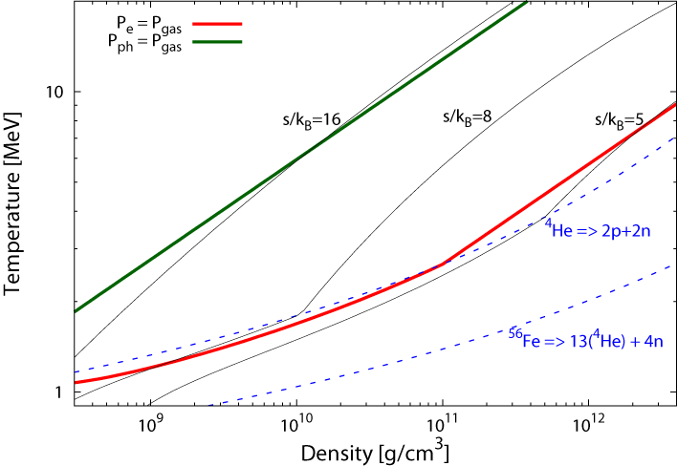
Three Initial Models
Evolution path is characterized by central entropy (mass)
More Massive Stellar Core
Radiation pressure dominant
Gas pressure dominant
Electron degenerate pressure dominant
Ordinary SN Core
Notes:
We adopted three initial models. Instead of explaining the detail of initial models, let me show you a qualitative difference between initial models. This figure shows density-temperature plane. The region can be divided into electron degenerate pressure dominated region, gas pressure dominated region, and radiation pressure dominated region. Ordinary SN core goes through this electron pressure dominated region and more massive star whose central value of entropy per baryon goes through like this.

Slide 11
Three Initial Models
Rotational Profiles are added by hand
500 Msolar Model : Ohkubo et al. (2006)
Mcore ~20Msolar
Simplified Model Nakazato et al, (2007)
Mcore ~ 10Msolar
100 Msolar Model :
Umeda & Nomoto (2008)
Mcore ~ 3Msolar
Notes:
And we adopted three initial conditions: Two models calculated in stellar evolution and one intermediate simplified model.

Slide 12
Comments on progenitor model of GRB
GRB engine： BH＋Disk (assumption)
The progenitor core should be rapidly rotating
⇔ Type-Ic SN association :
J loss at the same time of H, He mass loss
Note that magnetar models also face this problem
Some specific models required
He star merger model (Fryer & Heger 2005)
Tidal spin up model (van den Huevel & Yoon 2007)
Chemically homogeneous evolution (Woosley & Heger 2006, Yoon et al. 2006)
Strong mixing will be accompanied in all models
The entropy per baryon (S) of the core will become higher
Assumption: GRB progenitor core may have high S

Slide 13
BH formation 2010-2011: Results
Sekiguchi & Shibata , ApJ 737, 6 (2011)
Sekiguchi & Shibata , in preparation
Without Magnetic fields
Please see how NR simulations have been developed since 2005.

Slide 14
Collapse of 100Msolar presupernova model
Two rotation models (Moderate and Rapid rotation)
Radiation pressure dominant
Gas pressure dominant
Electron degenerate pressure dominant
Notes:
OK, let me first show you the results of collapse of 100 Msolar model. We consider two rotational profile: Moderate rotation and Rapid rotation. Let me first show you animation in moderately rotating model
This figure shows density contour just before the core bounce. Recall that the collapsing core experiences the core bounce due to the strong repulsive nuclear force when the central density exceeds the nuclear matter density. The top panel shows time evolution of neutrino luminosities and the diamonds indicate time-step.

Slide 15
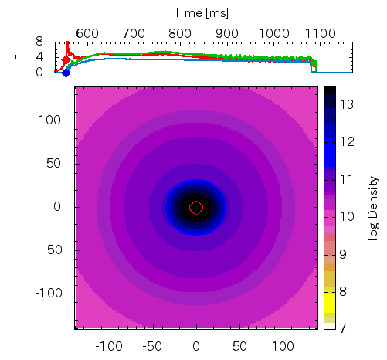
Collapse of 100Msolar presupernova model
‘Moderately’ rotating model (Ω_{c}=1.2 rad/s, Ω_{Fe}=0.6 rad/s)
10⁵³ erg/s
280km
Notes:
OK, let me first show you the results of initial condition which goes this way. I will show you results in two rotational profile: Moderate rotation and Rapid rotation. Let me first show you an animation in moderately rotating model
This figure shows density contour just after the core bounce. Recall that the collapsing core experiences the core bounce due to the strong repulsive nuclear force when the central density exceeds the nuclear matter density. The top panel shows time evolution of neutrino luminosities and the diamonds indicate time-step.

Slide 16
Collapse of 100Msolar presupernova model
‘Moderately’ rotating model (Ω_{c}=1.2 rad/s, Ω_{Fe}=0.6 rad/s)

Slide 17
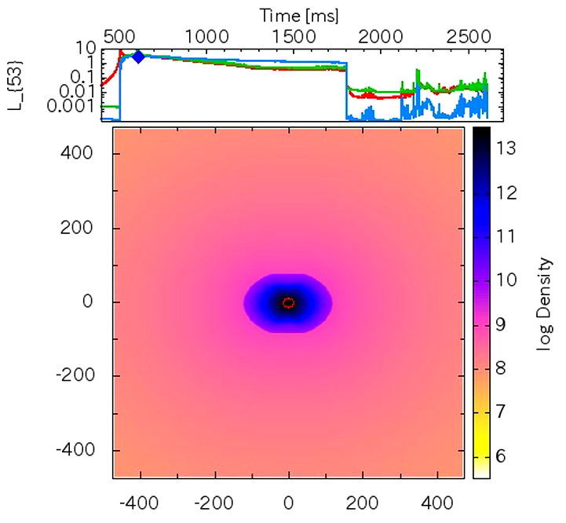
Collapse of 100Msolar presupernova model
‘Rapidly’ rotating model (Ω_{c}=1.2 rad/s, Ω_{Fe}=1.2 rad/s)
10⁵³ erg/s
980km

Slide 18
Collapse of 100Msolar presupernova model
‘Rapidly’ rotating model (Ω_{c}=1.2 rad/s, Ω_{Fe}=1.2 rad/s)

Slide 19
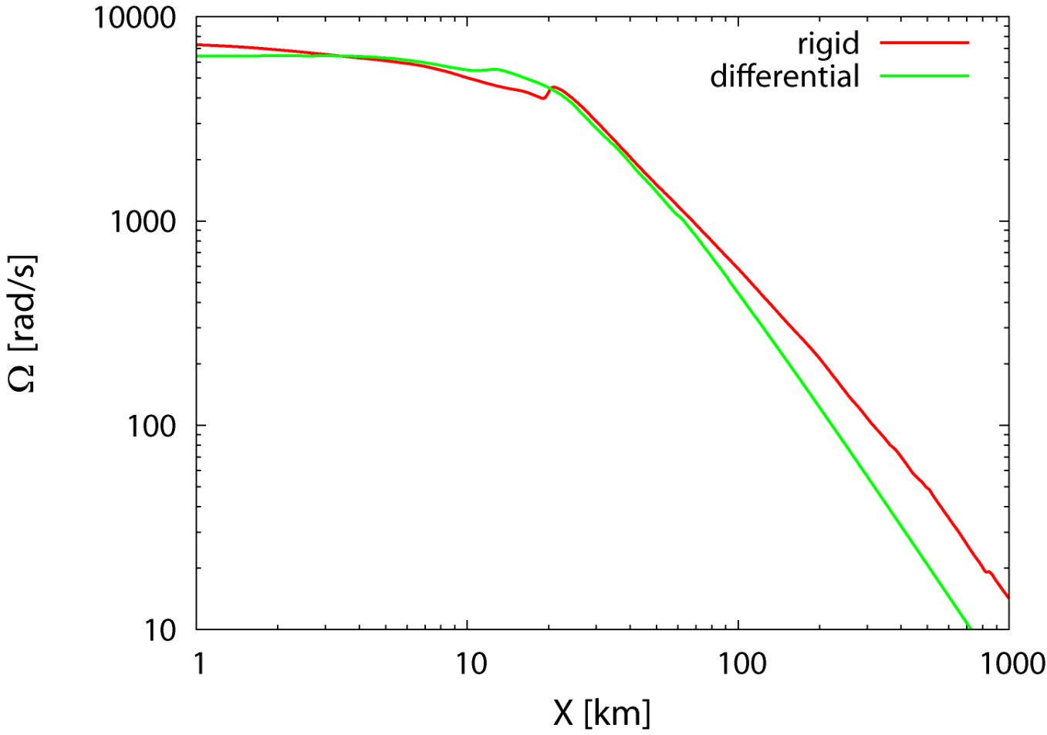
Rotational Profile of PNS
Rotational profiles of Proto-Neutron Star are similar
Small difference in rotational profile of outer region results in large difference in dynamics
rapid
moderate
PNS
Rapid
Moderate
Notes:
In this figure, we compare the rotational profile of the core just before the BH formation in the rapid and moderate rotation.
Rotational profiles of PNS are similar and those in the outer region is slightly different.
This means that small difference in rotational profile of outer region results in large difference in dynamics

Slide 20
Importance of Rotation : Oblique Shock
Rapid rotation:
Torus-structured shock
Infalling materials are accumulated into the PNS due to the oblique shock
Thermal energy is efficiently stored near the pole of PNS
Ram pressure ↓
⇒Outflow
Flows hit central NS
NS oscillation
⇒ PdV work , Lν ↑
Notes:
Among the effects of rotation, formation of oblique shock plays an important role. In the rapidly rotating model, Torus-like shock is formed. At this torus-like shock wave, the infalling matter experiences the oblique shock. And flows are bent towards the shock surface. This results in accumulation of infalling matter into the pole of the PNS. Thus, the thermal energy is efficiently stored near the pole of PNS. Because the ram pressure is decreasing, an outflow is launched when the pressure of this overheated region becomes larger than the ram pressure.

Slide 21
Importance of high entropy
More compact core ⇒ high mass accretion rate
Local energy valance may not be satisfied and there may be outflows or convection
Note that rotation decreases |Qadv|
Strong dependence of Qν on T and ρ ⇒ slight change of configuration may leads to dynamically large chance
We must quantitatively draw phase diagram in Rot.-S plane
Very time consuming : some analytic treatment required
Smaller amount of heavy nuclei
Dissociation of 0.1 Msolar Fe costs ~ 10⁵¹ erg
Higher temperature
Less Pauli blocking in neutrino pair annihilation

Slide 22
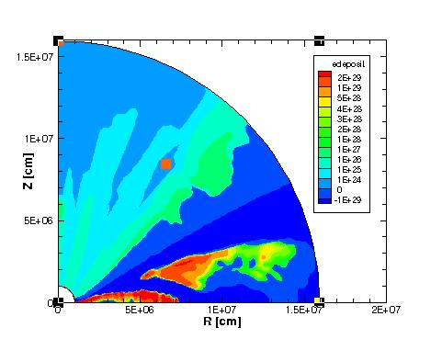
Similarities with ordinary SNe
Components identical : ν-sph./torus and stalled shock
Topology is different : Spherical vs Torus
There are “gain” regions ! (Sumiyoshi+ 2012)
SASI does occur (Sekiguchi+ 2012 on going simulation)
How does this system
evolve in the presence
of neutrino heating
(GR-RadHydro simulation
Sekiguchi+ 2012 of 2013)
Preliminary

Slide 23
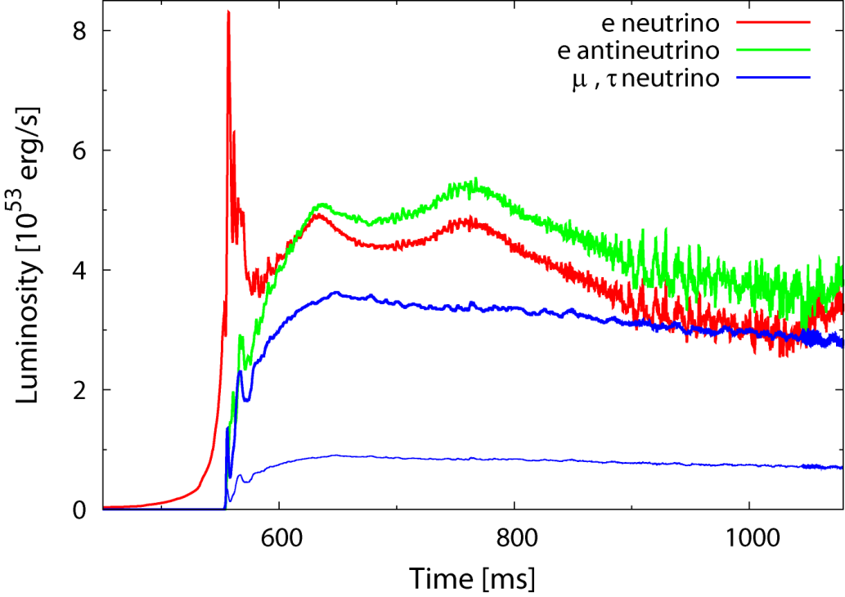
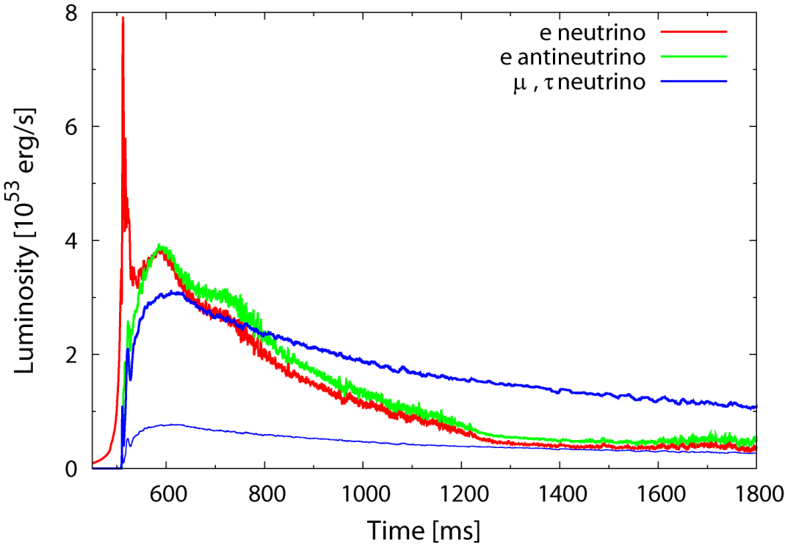
Neutrino Luminosity (PNS Phase)
Moderate rotation
Higher luminosity
Time variability due to convective activity
Rapid rotation
Lower luminosity
Neutrino pair production processes are dominant
Neutrino burst
Core bounce
Notes:
This figures compare the neutrino luminosities in the PNS phase. Neutrino luminosities in Moderately rotating model are slightly higher than those in rapidly rotating model, which reflect the compactness of the system. Also luminosities in moderately rotating model show time variability due to the convection.

Slide 24
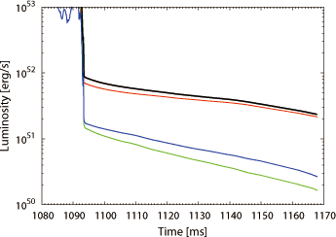
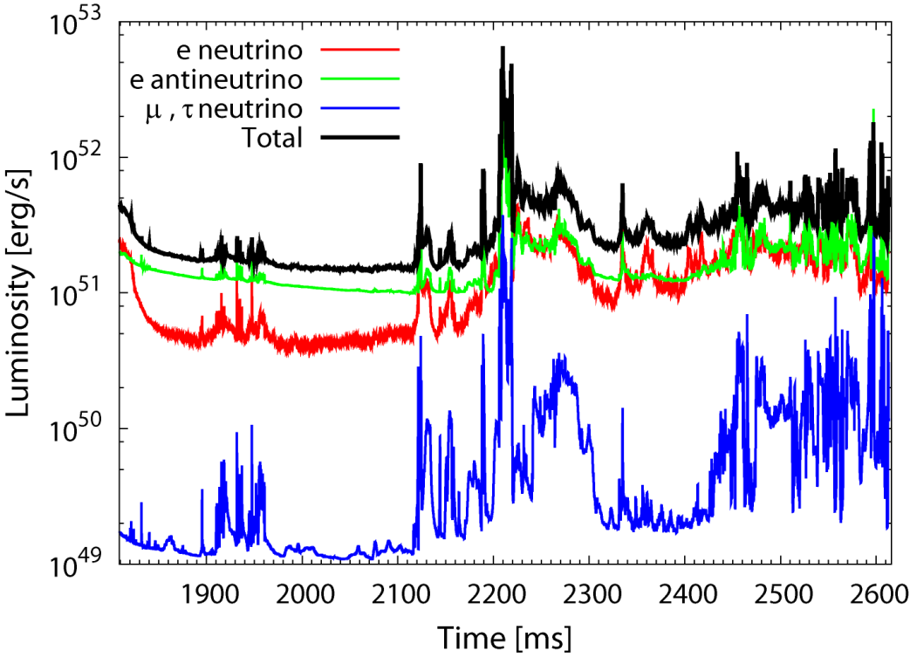
Neutrino Luminosity (BH Phase)
Moderate rotation
Ltot ~ 10⁵¹⁻⁵² erg/s
No time variability
Rapid rotation
Ltot ~ 10⁵¹⁻⁵² erg/s
Violent time variability
Preferable feature for GRB
Notes:
This figures compare the neutrino luminosities after the BH formation. Because neutrino sphere is swallowed into the BH, the luminosity decreases sharply. And then, the disk emits neutrinos. The remarkable features are large neutrino luminosities and violent time variability found in the rapidly rotating model, which is preferable feature for GRB.

Slide 25
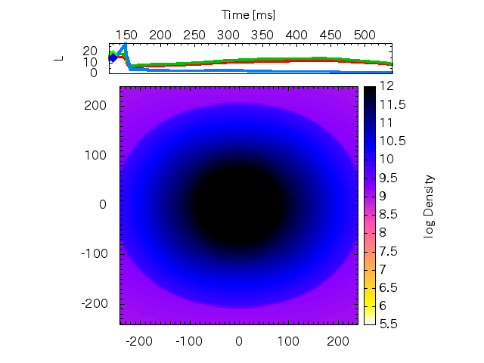
Collapse of 500M_{solar} PopIII stellar core
Rapidly rotating model (Ω_{c}=5 rad/s) : Direct BH formation
10⁵³ erg/s
10⁵³ erg/s
Radiation pressure dominant
Gas pressure dominant
Electron degenerate pressure dominant
480km
Notes:
Now I will show you the results in the collapse of 500 Msolar popIII stellar core. In this case, because the core is very massive, a BH is directly formed.

Slide 26
Collapse of 500M_{solar} PopIII stellar core
Rapidly rotating model (Ω_{c}=5 rad/s) : Direct BH formation

Slide 27
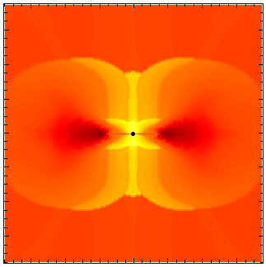
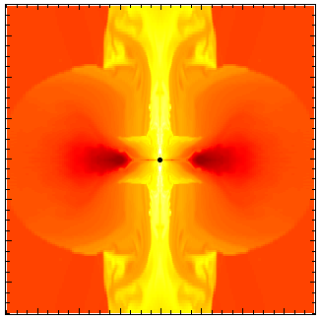
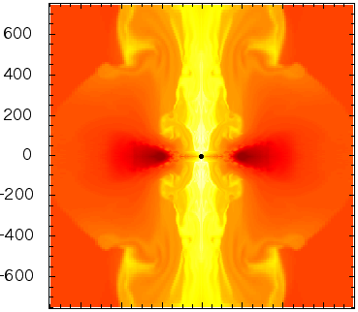
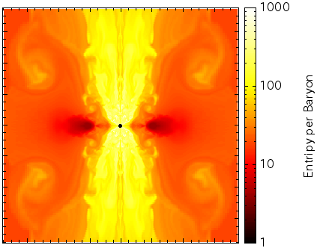
Outflow appears even when BH is formed
Infalling materials are accumulated into the central region due to the oblique shock
At a later phase BH is surrounded by shock waves
Advection of energy into BH becomes less efficient
Thermal energy is stored
Outflow
1900km
Entropy per Baryon

Slide 28
Collapse of 500M_{solar} PopIII stellar core
Slowly rotating model (Ω_{c}=3 rad/s)

Slide 29
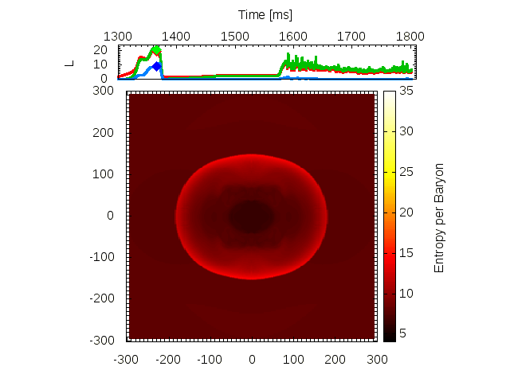
Moderately High entropy core
Moderate rotation (Ω_{c}=0.5 rad/s)
10⁵³ erg/s
Radiation pressure dominant
Gas pressure dominant
Electron degenerate pressure dominant
600km

Slide 30
Moderately High entropy core
Moderate rotation (Ω_{c}=0.5 rad/s)

Slide 31
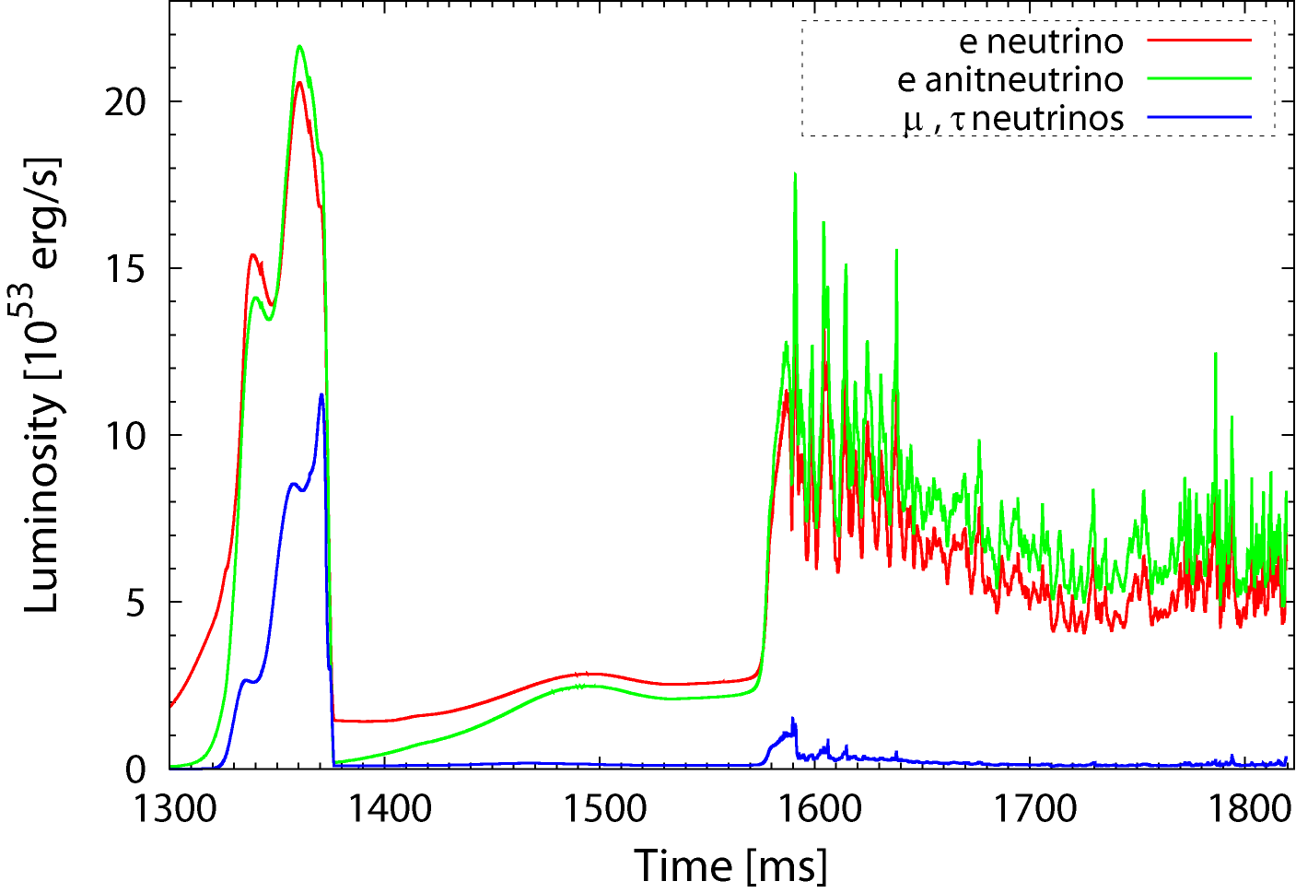
Neutrino luminosity
Thick torus emits L ~ 10⁵⁴ erg/s, time-variable
Thin disk emits L ~ 5・10⁵³ erg/s

Slide 32
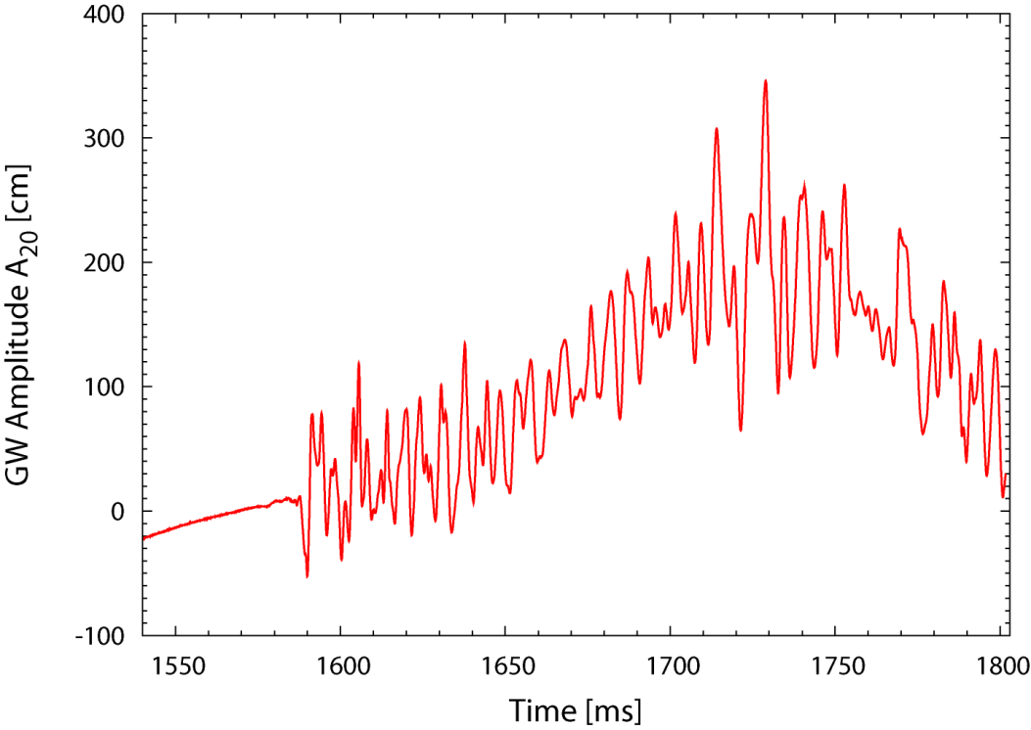
GW from disk convection

Slide 33
Summary
The first full GR simulations, incorporating microphysics, of stellar core collapse are performed, adopting various initial models
BH formation process is quite dynamical, accompanying oblique shock, convection, KH instability and outflows
The dynamics is very sensitive to the initial rotational profile which is poorly known
Accumulation of material (energy) into the pole region of the central object is a key feature for driving an outflow
Outflows can be driven even when BH is directly formed
The resulting system has preferable features for LGRBs
Connection between variation in LGRB and variation in dynamics ?

Slide 34
Future studies
Beyond GR leakage scheme : GR-Radiation-Hydrodynamics based on Thorne’s moment formalism
Formulation：Shibata et al. 2011
Simplified BH –Disk GR-Rad-MHD simulation : SS 2012
Detailed microphysics ver. completed: YS+ 2012
3D simulation
Papaloizou-Pringle instability of the Disk (Kiuchi et al. 2011)
Torus-Shaped shock SASI + heating
Convection vs MHD processes (e.g. MRI)
GR-leakage+-MHD
Same method as in Kuroda+ 2012

Slide 35
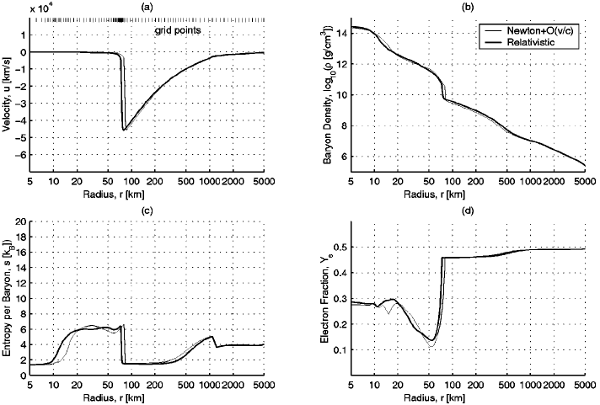
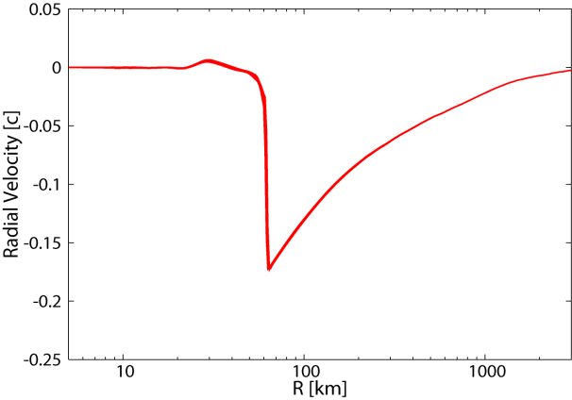
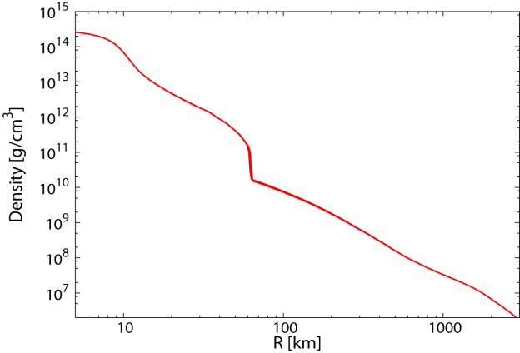
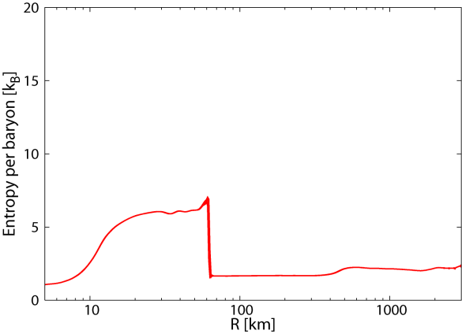
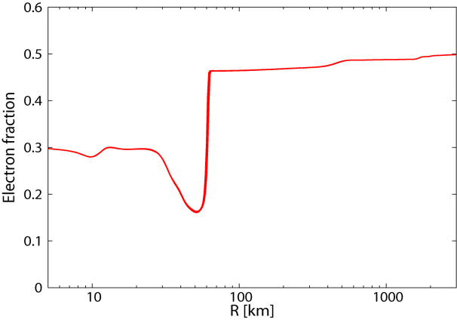
Going Further: GR-RadiationHydro
Full GR RadHydro based on Moment method
Sekiguchi+ 2012 in prep.
1D GR Boltzmann
Liebendoerfer+ 2001

Slide 36
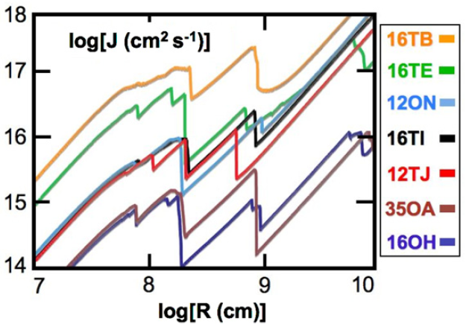
More realistic rotational profile
Relation between GRB time profile and rotational profile ?

Slide 37
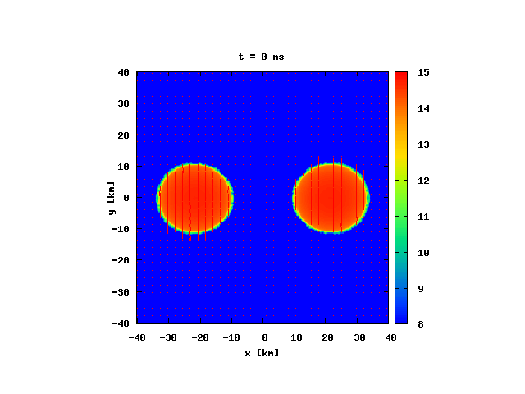
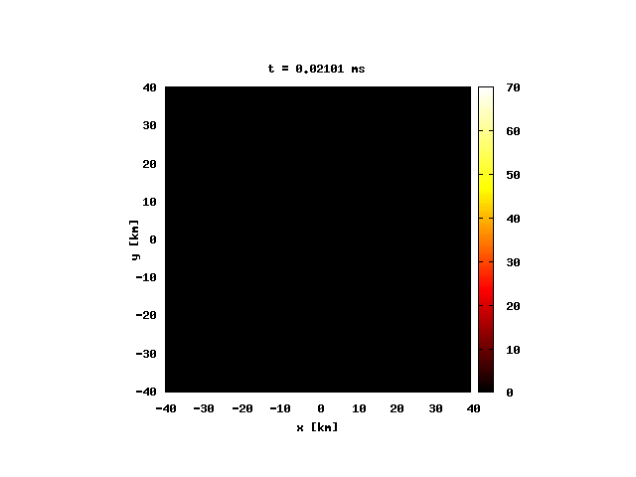
Binary neutron star mergers
Providing fluid background necessary to compute r-process in BNS merger (semi-quantitative study)
Sekiguchi et al. 2011a, 2011b (Simulations in Leakage scheme)
Density [ log₁₀ g/cc]
Temperature [ MeV ]

Slide 39
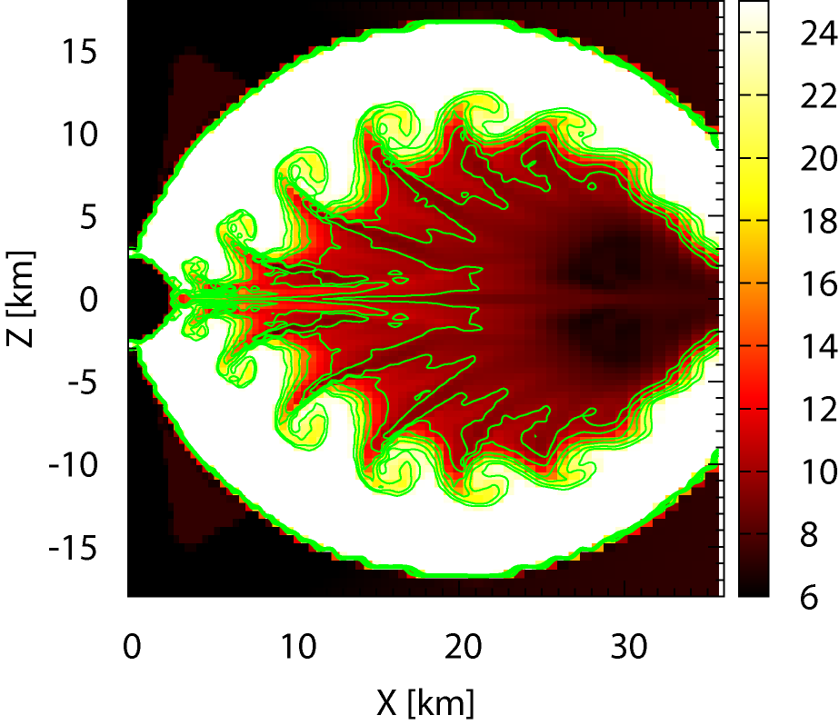
KH instability
Infalling matter v ~ 0.3c
Convective eddy ~ 0.1c

