Slide 1

Formation of quark stars
J.E. Horvath
IAG – USP São Paulo, Brazil

Slide 2
Two important variants:
When: Prompt (~ ms to s) or late (Myr) ?
Which: Stable at high pressure or self-bound (SQM)?

Slide 3
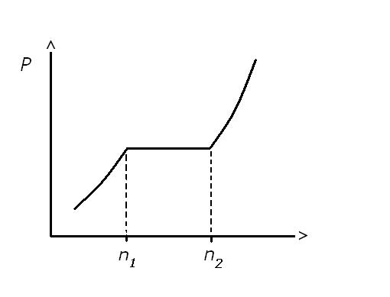
Quarks inside stars ?
High-density QCD : equilibrium (Maxwell)
transitions calculated in the `70s
(Collins & Perry 1975 , Baym & Chin 1979 ...)
Drop of pressure
across the transition,
shrinking of stellar
structure
Global conservation vs. local conservation
(Glendenning)
Boundary layer (dielectric)
counterexample

Slide 4
Work on hypothetical self-bound QCD phases
(Bodmer 1971, Terazawa 1979, Witten 1984) :
E/A < 939 MeV even at P=0 !!!
Gibbs
free energy
per particle
Non-equilibrium
transition !!!

Slide 5



SQM : Nucleation classical
quantum
Alcock & Olinto 1989
Slominski 1990
Horvath, Benvenuto & Vucetich 1992
Grassi 1997
Olesen & Madsen 1993
Iida & Sato 1997
Horvath 1994
(
)
Nucleation
rate

Slide 6



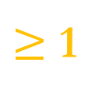
Nucleation
rate
$$×$$
Available
time
$$×$$
Nucleation
volume
$≥$ 1
$$T≥1 MeV$$
* Probably dominated by thermal effects at T > 1 MeV , quantum
fluctuations important afterwards if early nucleation is not achieved
* Curvature term and chemical state VERY important, neutrinos must
go to easy the first bubble
*New work by Bombaci, Lugones et al. (out of chemical equilibrium
Including pairing energy etc.)

Slide 7
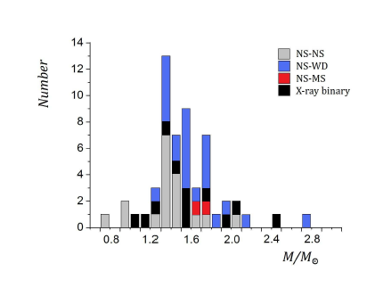
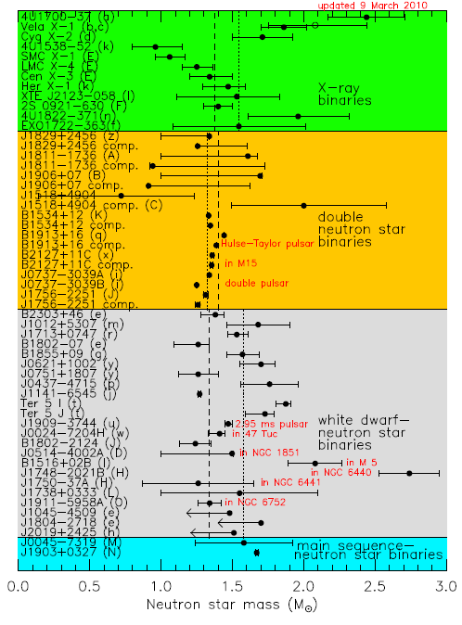
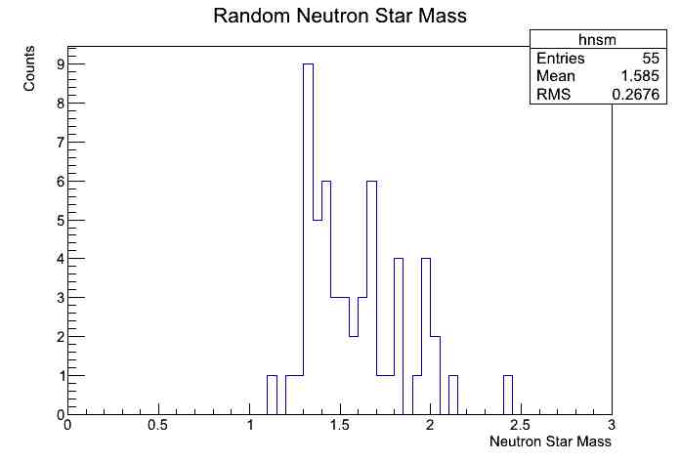
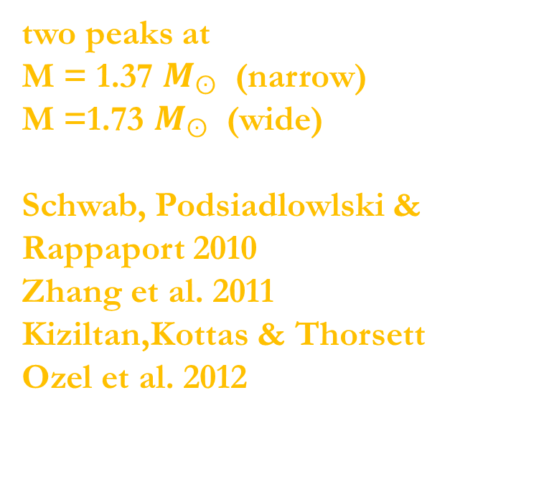
Sample compiled by
Lattimer et al 2011
Much wider range
of masses “one mass” gone
Bimodal distribution
(Valentim, Rangel &
Horvath MNRAS 2011)
“new” view
two peaks at
M = 1.37 $M_{ʘ}$(narrow)
M =1.73 $M_{ʘ}$ (wide)
Schwab, Podsiadlowlski&
Rappaport 2010
Zhang et al. 2011
Kiziltan,Kottas&Thorsett
Ozel et al. 2012

Slide 8
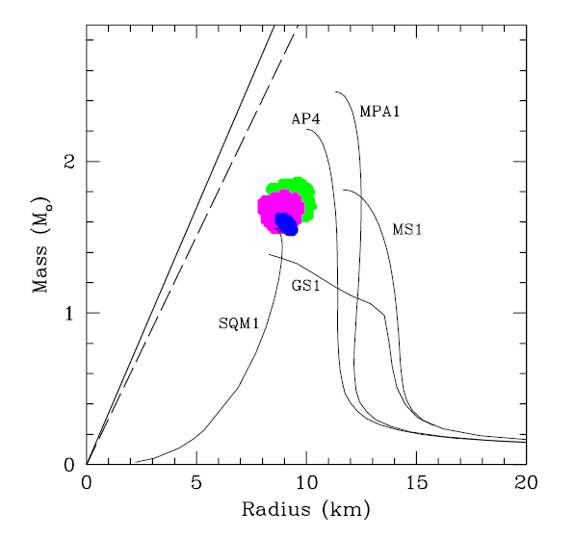
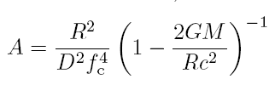
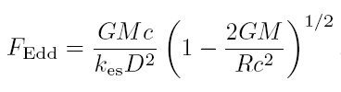
Important news in NS physics
Measurements of masses and radii: bursters
Apparent area
Eddington flux
Ozel, Güver et al.

Slide 9
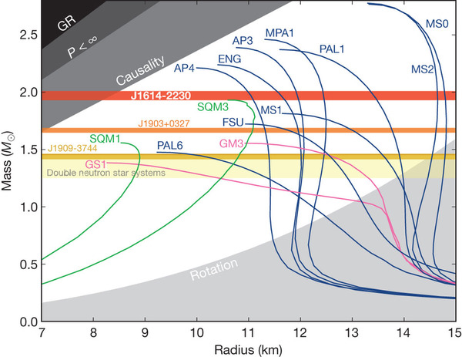
Demorest et al. Nature, 2010
Limits to a quark core Alford et al, Rodrigues et al

Slide 10
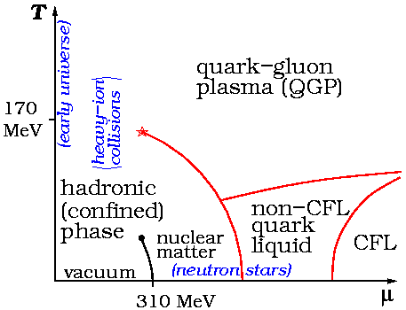
Is there still room for “pure” SS ?
SQM vs. CFL Strange Matter
The quest for the ground state
Pairing in quark matter
(Barrois 1979, Bailin & Love 1984...)
small gaps Δ ~ 1 MeV, considerable uncertainty
New round of calculations:
pairing stronger and richer
structure large gaps
up to Δ ~ 100 MeV

Slide 11

SQM vs. CFL Strange Matter
difference of equilibria
The CFL case
Chemical equilibrium
(equal Fermi energies)
Electrical neutrality
Chemical equilibrium
(equal Fermi momenta)
Electrical neutrality is
automatic (no electrons)

Slide 12


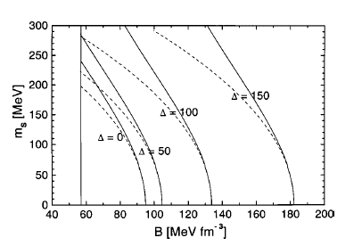

Absolute stability
condition
Boundary of the
stable region
Parabolic approx.:
dashed line

Slide 13

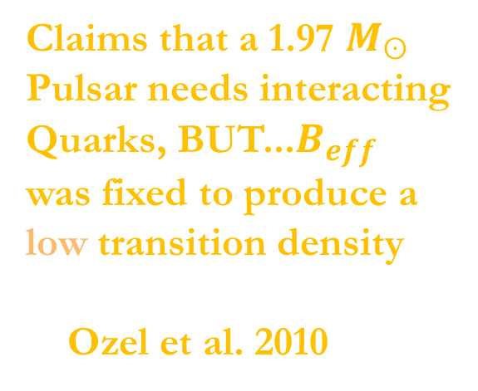
Applies to a quark core, not to a self-bound star

Slide 14
CFL case
We could start from the same free energy parametrization (Alford & Reddy), changing only the Beff
but... Parametrizations may lead to signifitant errors ~ 5-10 %.
Example (Benvenuto & Horvath, 1989)
Dependent on in general, and also correlated

Slide 15


“Brute force” approach , without parametrization and self-bound
matter
with
Very linear still EoS, but contains
all the dependence

Slide 16
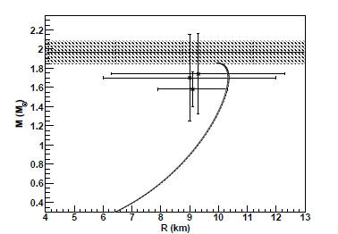
What happens if all the points (Ozel+Demorest)
are required to be explained simultaneously ?
ONE point
in parameter space

Slide 17
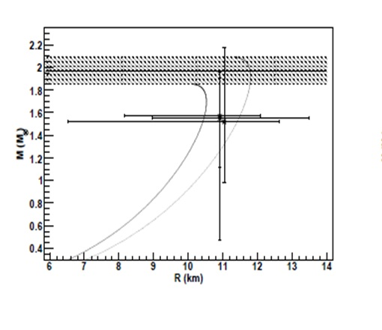
Steiner, Lattimer & Brown: R >> R
photo
star
Now, a much large set of values is allowed

Slide 18
Quark matter EoS are not soft,
even with free quarks
Vacuum is very relevant, and pairing interactions too
The question should be shifted to the latter: Which are their minimum values?
Are they realistic?

Slide 19
Why care about self-bound models ?
Role of hyperons in hadronic matter : included in some NR form, they tend to soften the EOS. Threshold at 2-3
Interactions of hyperons with p,n still uncertain
Generally H-n and H-p interactions are not included
in the calculations
Existing EOS which behave quite stiffly either
Do not include hyperons
Include hyperons but use mean-field theories
(e.g. Walecka-type) instead of a microscopic approach
(M.Baldo, F. Bugio & co-workers…)

Slide 20
Why mass determinations around and well
below are so important ?
Two examples:
PSR J0751+1807 Demorest et al. 2010
4U 1538-52 Rawls et al. 2011

Slide 21
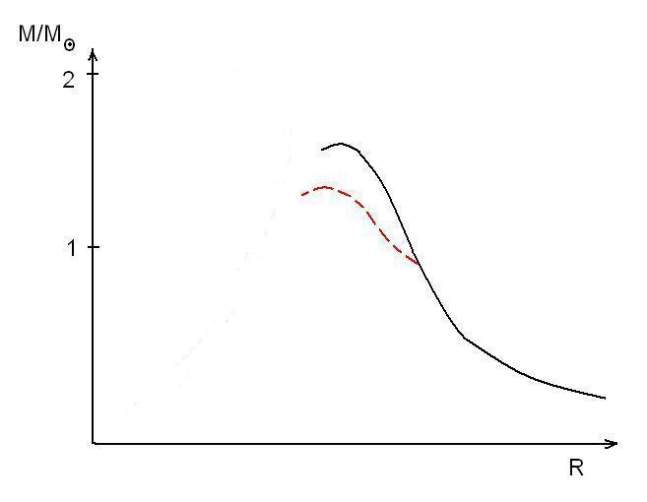
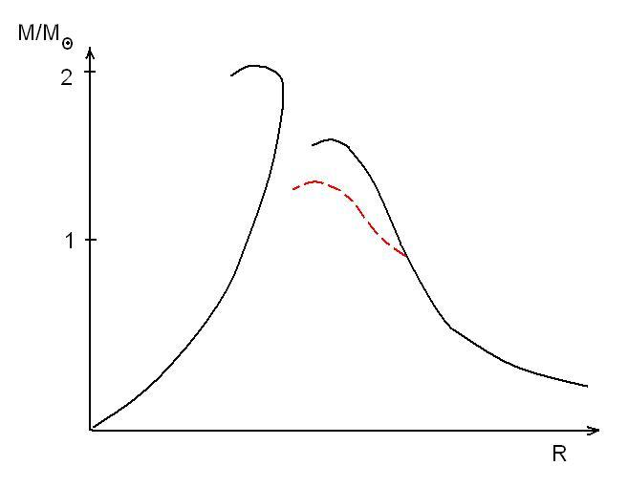
What do these determinations mean and how are
these objects formed?
EOS with
Hyperons
Mmax<1.8
“Exotic” self-bound
EOS w/appropiate
vacuum value

Slide 22
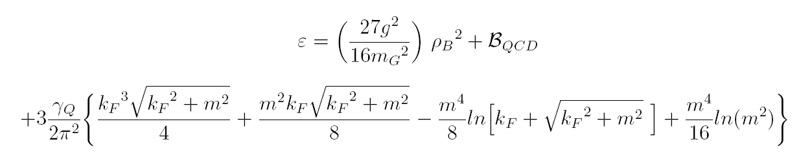
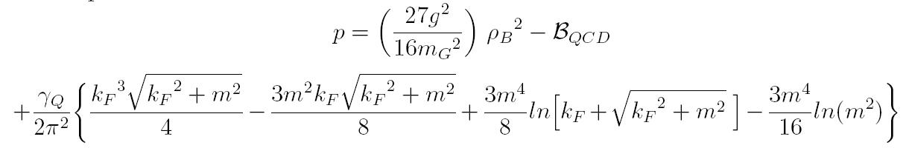
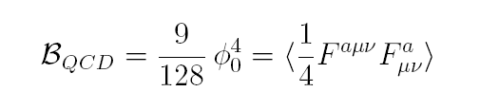
Mean Field Theory of QCD (Navarra, Franzon, Fogaça & Horvath)
soft gluons → condensates order 2nd and 4th → soften EoS
hard gluons → large occupation numbers: classical → harden EoS

Slide 23
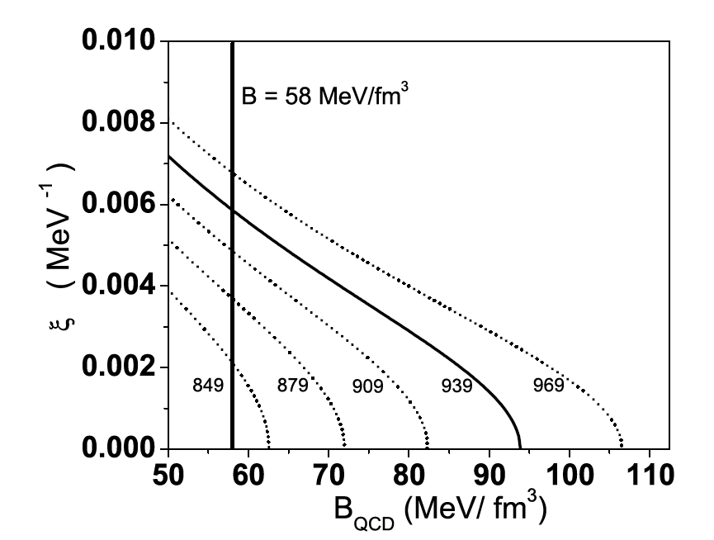
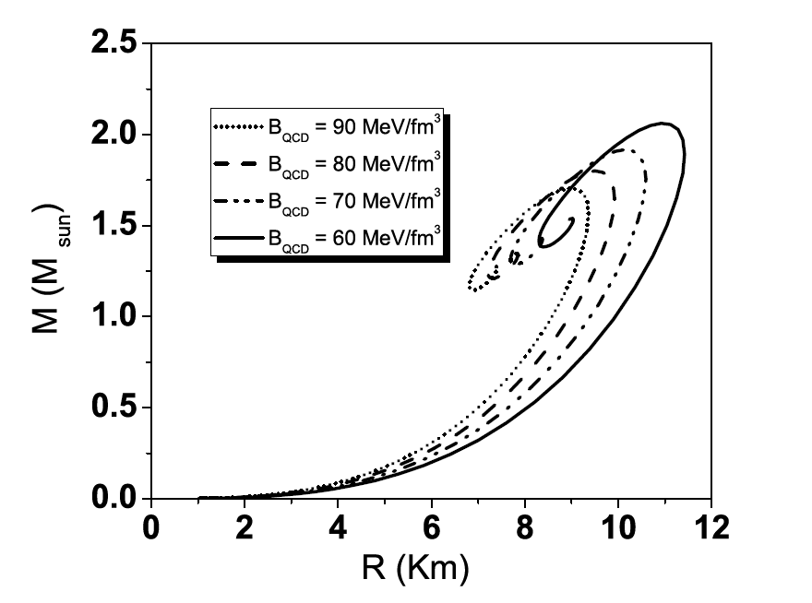

Stability
window
Quark matter EoS are not
soft at all
Dynamical
gluon mass

Slide 24
Appearance of quarks on dynamical timescales
Again two possibilities: ~ ms (prompt) or ~s (delayed)
and of course, two versions of quarks: plain or self-bound

Slide 25
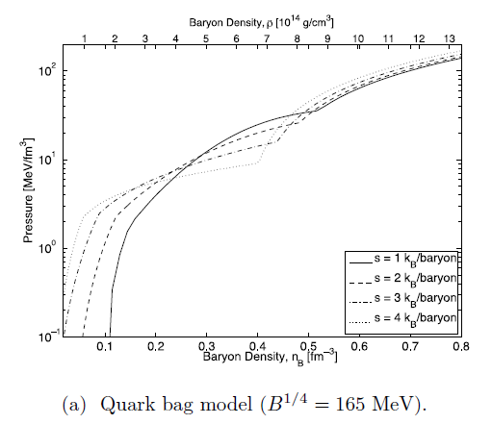
Appearance of the (mixed) quark phase at ~ 3
(“normal” version, no SQM)

Slide 26
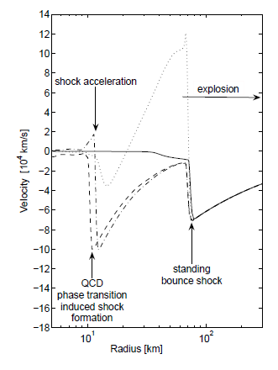
A second shock develops @ 300 ms after bounce, helps ejection
T. Fischer et al 2011
Takahara & Sato
Gentile et al.
Janka et al.
...

Slide 27
What about SQM? Unlikely to appear that soon
(prompt nucleation disfavored)
Neutrinos should go for SQM to appear (Lugones & Benvenuto)
This means ~ seconds after bounce (diffusion timescale)
Once a seed of SQM is present, the propagation is akin to a
combustion n → uds + energy, analogue to SNI at high density

Slide 28
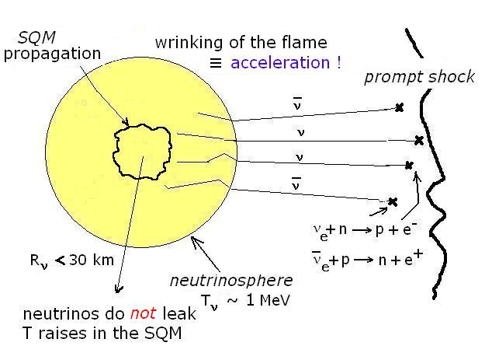

$$u_{lam}$$
Attempts to calculate laminar velocities
(Baym et al. 1985, Olinto 1988,
Madsen & Olesen 1991, Heiselberg & Baym 1991)
Too centered in laminar diffusive physics, conversion takes ~ 1 minute

Slide 29
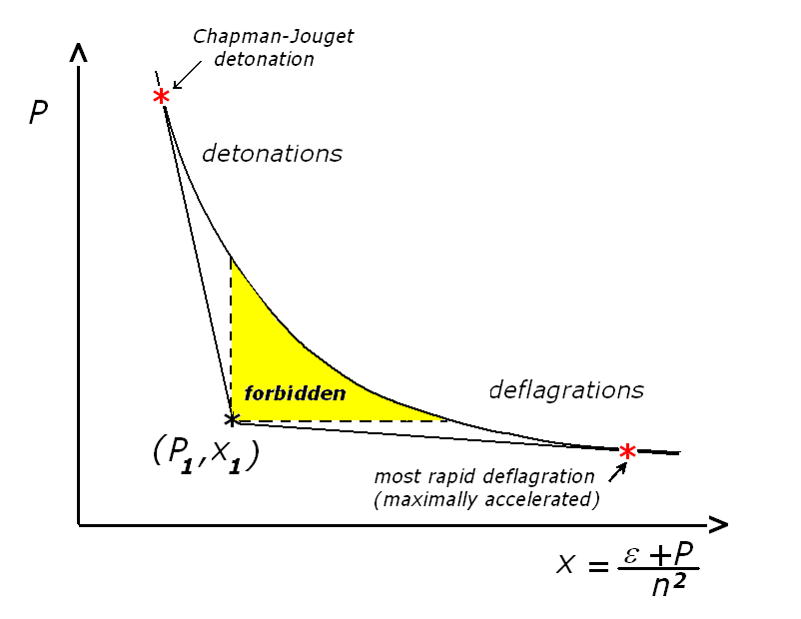

Slide 30


Early stages of the n → SQM combustion
Landau-Darrieus
(small λ)
and Rayleigh-Taylor instabilities (large λ)
Wrinkling of the flame, cellular structure and acceleration
Minimum scale still deforming the front (Gibson)

Slide 31


Numerical simulations (Herzog & Ropke 2011)
MIT Bag EoS for the SQM, “large eddy” simulations, no cooling
Eddies do not disturb
the flame front (flamelet)
Geometrical enhancement
of the speed, even below resolved
Flame front always sharp,
even considering an average
~ 1 m width
Alternative to the fractal expression

Slide 32
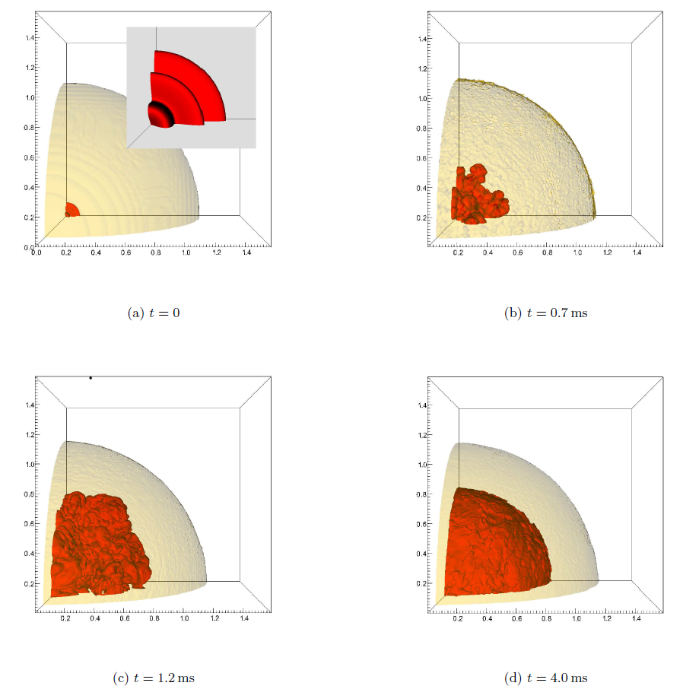
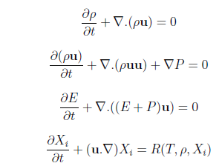

Reactive Euler equations
!!!

Slide 33

The distributed regime and detonations (DDT?)
Mixed regions interact with turbulence, necessary
To “jump” (Zel´dovich gradient) mixed burning should de
synchronized inside a macroscopic region , perhaps not
larger than ~1 cm or so (?). May not occur or start at “t=0”

Slide 34
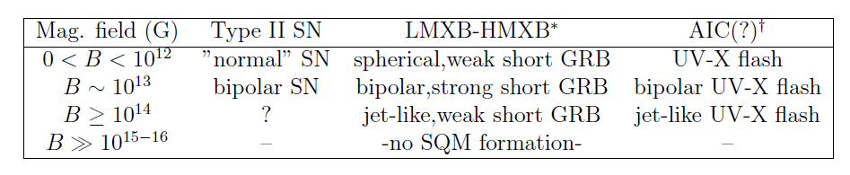
Possible effects of a SQM energy source
Direct action on the stalled shock, detonation “desirable”
Benvenuto & Horvath 1989
Indirect revival of the shock (fresh neutrinos)
Benvenuto & Lugones 1995
“Photon-driven” SN by radiation of the SS surface
Xu, 2003
Within the SQM hypothesis, all compact star formation events
would release this extra energy (propagation affected by B) yielding

Slide 35
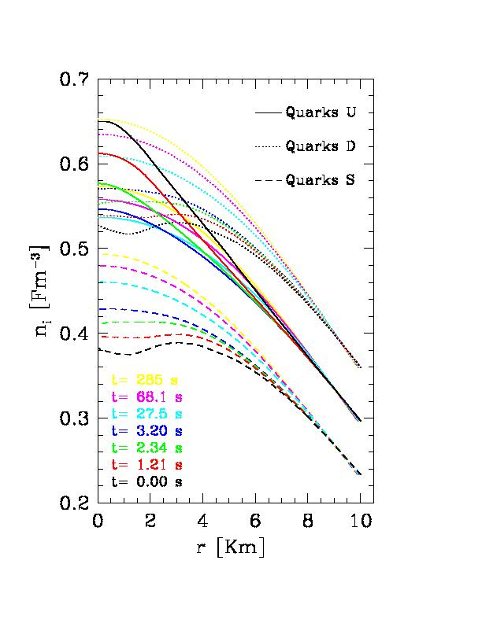
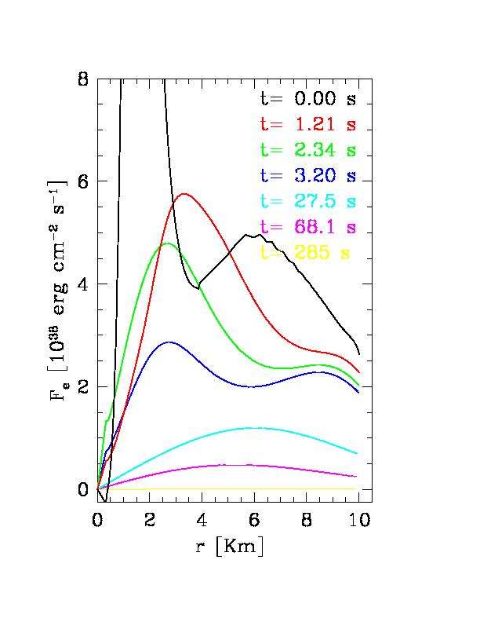
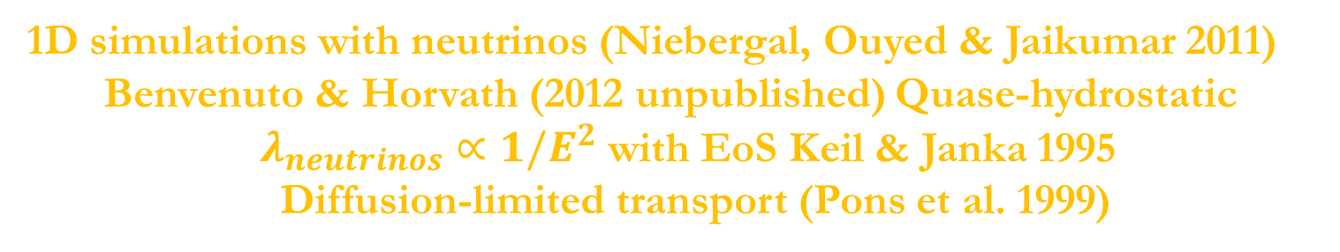
1D simulationswith neutrinos (Niebergal, Ouyed&Jaikumar 2011)
Benvenuto&Horvath (2012 unpublished) Quase-hydrostatic
$λ_{neutrinos}∝1/E^{2}$withEoSKeil&Janka 1995
Diffusion-limitedtransport (Pons et al. 1999)

Slide 36
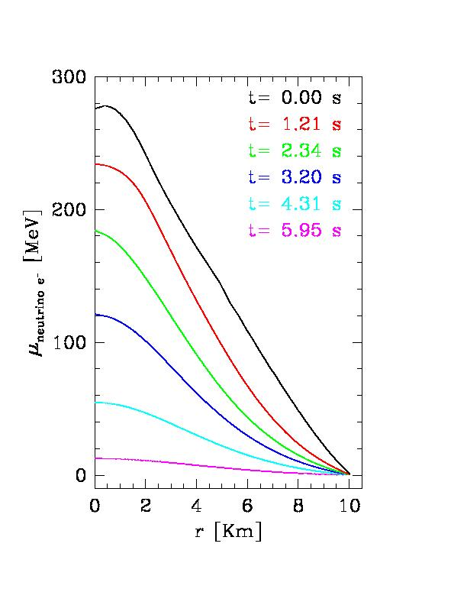
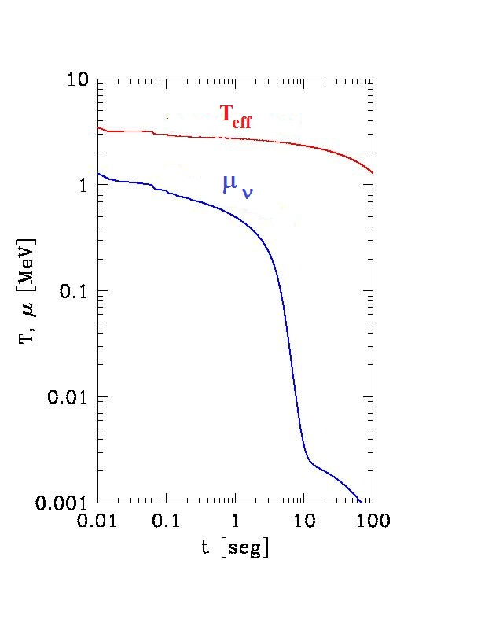

Slide 37
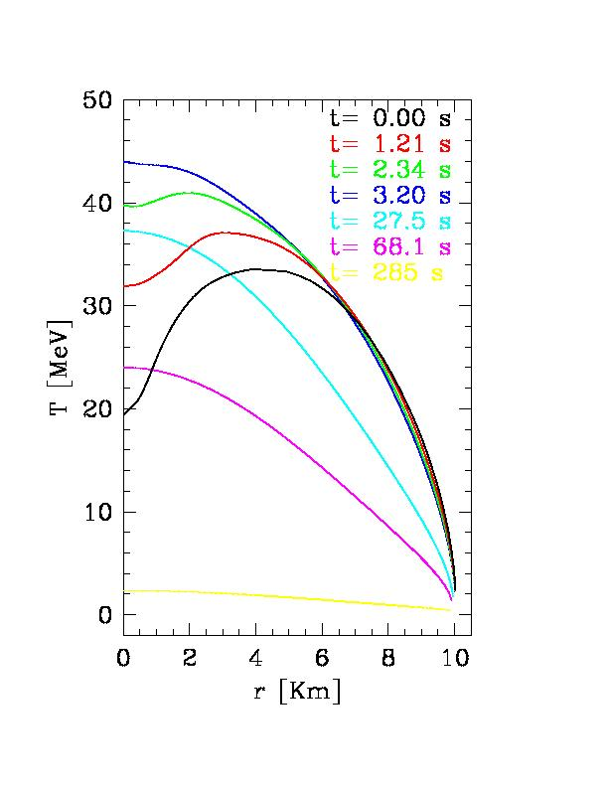
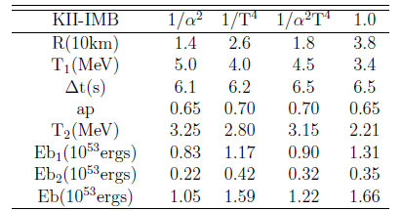

From the “latest” events
of SN1987A neutrino burst
(Benvenuto & Horvath, 1989)
$$T\sim 2 MeV$$
deleptonization
gap
Bayesian analysis suggests “two
bursts” always preferred to “one
burst” (even with more parameters

Slide 38


*
OBRIGADO
Shoichi & colleagues!
*
*

